Slide 1

Srishti Security Systems
DG-2/293-B
Vikaspuri
New Delhi-110018
Telefax-011-45875342
Mobile-09871971203/09999106708
Email-sagar@srishtisecuritysystems.com
sagarkn@gmail.com
website-www.srishtisecuritysystems.com
Service Centre
A-45,Chander Nagar,Rear Entry
2nd Floor, Janakpuri, New Delhi-110058
Channel Partners & Integrators- Kochi, Chennai, Lucknow

Slide 2
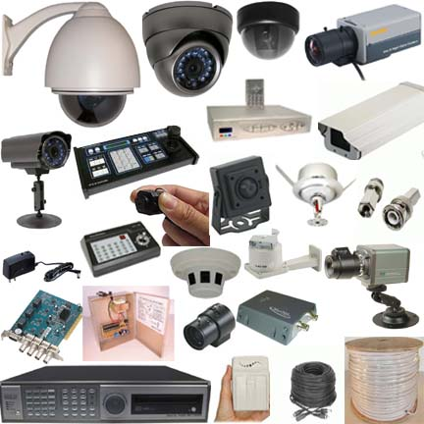




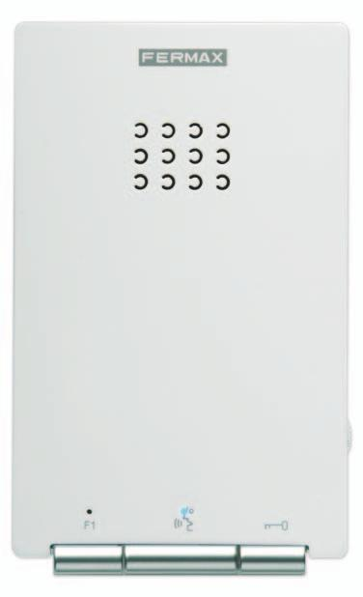
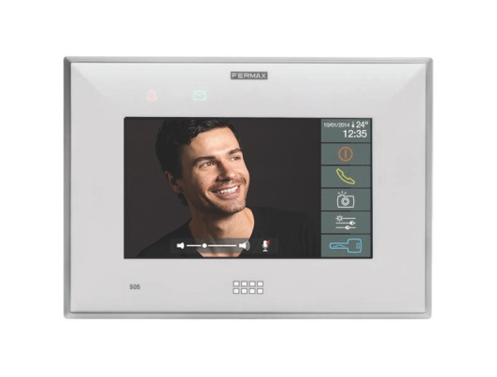
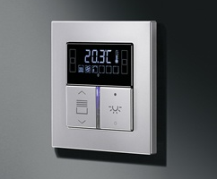
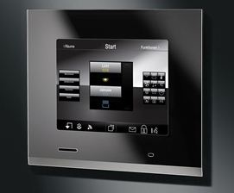
Product at a Glance

Slide 3
Mission
To become a strong service oriented Automation & Security Systems Integrator in India by recommending & providing value added solutions in track with changing trends.

Slide 4
Systems & Solutions
Access Control & Time Attendance - Biometric & Proximity- ZK & Syris
CCTV-Analogue & IP- CPPlus & Samsung
Fire Alarm-Analogue & Addressable-Apollo & Firetronics
Lighting Automation(KNX)-Jung
Lights-Osram & Spoon
Modular Switches-Jung
PA Systems- Bosch & JBL
Security Alarm with Sensors - Securico & Texicom
Video Door Phone – CPPlus & Fermax

Slide 5
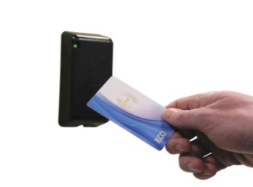
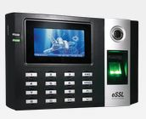
Access Control & Time Attendance – Biometric & Proximity ZK (ESSL) & Syris
RFID technology:
RFID smart card technology has revolutionized the business world. With the advancement in the technology the card based solutions has turned out to be one of the promising and economical solution. RFID technology has a proven track record and has tasted success over a decade since inception.
Fingerprint technology:
Fingerprint technology uses a person's fingerprints to identify him through fingerprint scanning. This technology is used not only in security systems but also in the field of forensic and crime scene investigations. With a combination of fast algorithms and high reliability, fingerprint technology has been used in various fields in the “biometric industry”.
Face Recognition technology:
With Vast experience in the field of biometric-fingerprint technology, we have diversified our research and development into face recognition technology. The outcome is a unique range of standalone face recognition products which are truly contactless and works on 1: N verification method.

Slide 6
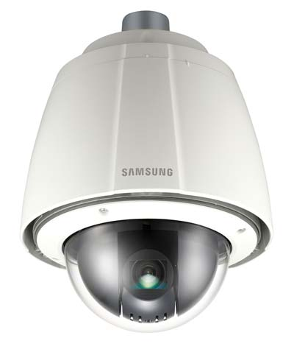
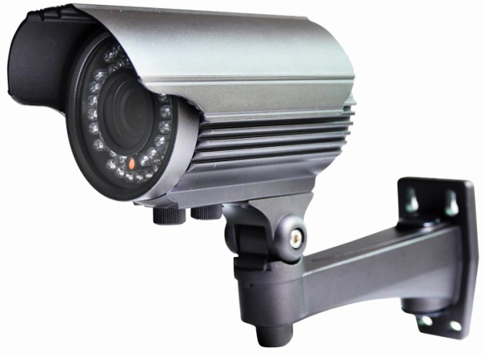
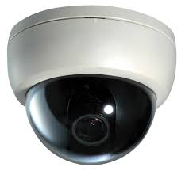
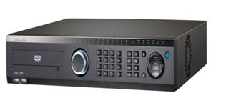
CCTV Analogue & IP
CPPlus & Samsung
Different Resolutions – 600 TVL, 700 TVL, 800 TVL, 1.3 MP, 2 MP, 4 MP etc.
Different Models – Dome, IR Bullet, PTZ, Varifocal etc.
Real time DVR and NVR with D1 recording

Slide 7
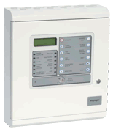

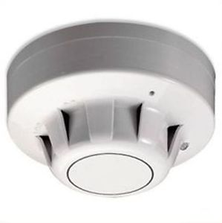

Fire Alarm Analogue & Addressable
Apollo & Firetronics
Apollo Fire Detectors Ltd is one of the world's largest manufacturers of smoke detectors, modules and notification devices.
Established in 1980, Apollo has become one of the top five manufacturers in the world specializing in the design and manufacture of high quality detection products.

Slide 8

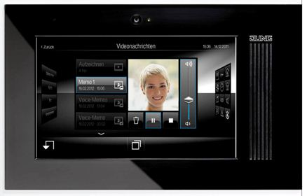

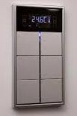
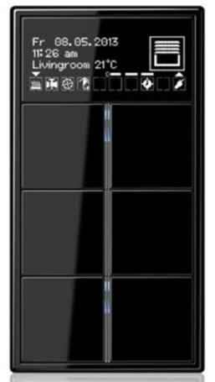
Lighting Automation (KNX) - JUNG
KNX an ultimate open protocol in home automation. One can easily integrate lights, blinds, audio visual, aircon, security etc.
KNX is lifestyle and comfort

Slide 9

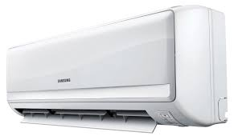
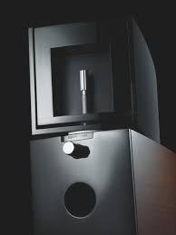

Integration with
3rd Party ( IPAD, AC & MUSIC) Gateway

Slide 10





Modular Switches - JUNG

Slide 11
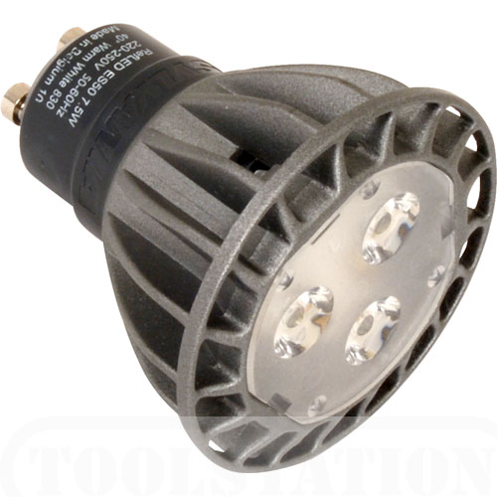

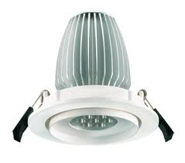
LED Dimmable Lights – Osram & Spoon

Slide 12



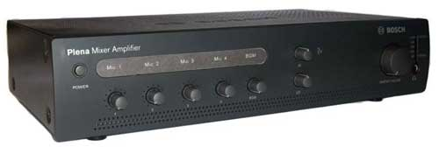

PA Systems JBL & Bosch Ultimate and time tested audio systems.

Slide 13
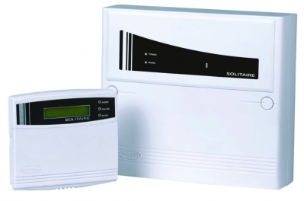
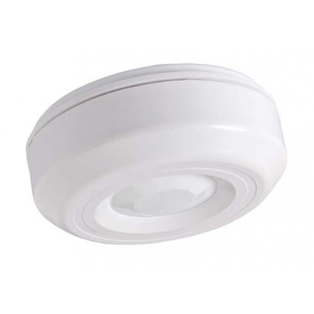

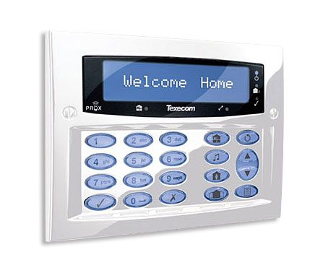

Security Alarm with sensors
Securico & Texicom
Various range of sensors: Glass, Magnetic, Motion, Shutter Vibration etc.

Slide 14
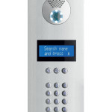
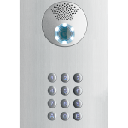
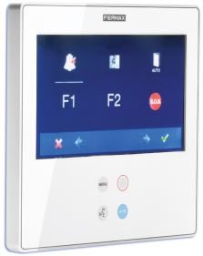
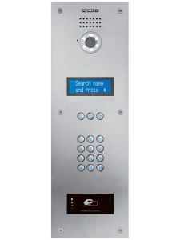
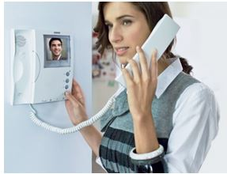
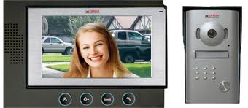
Video Door Phone – CPPlus & Fermax
Different types of panels and monitors for villas and apartments

Slide 15














Some of our clients

